Slide 1
BT2101 Tutorial 1

Slide 2

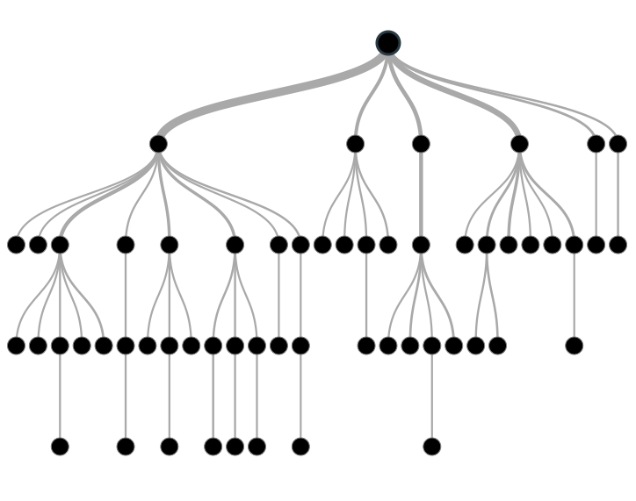

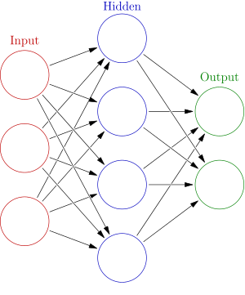
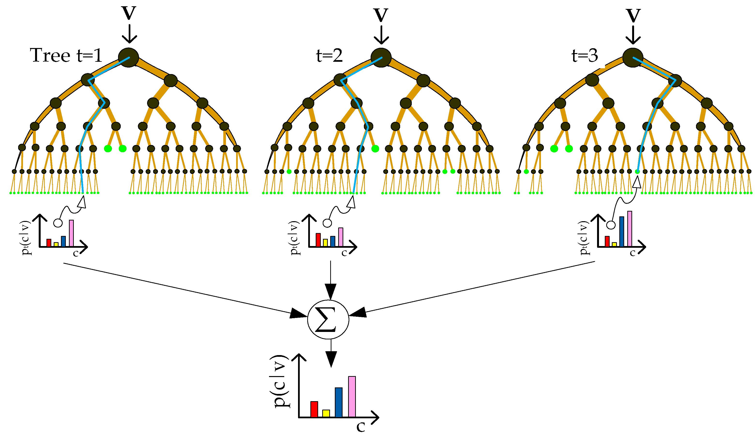
Purpose of Tutorial
Time Series
Decision Tree
Ensemble Learning
Neural Networks

Slide 3
Agenda
Form a team of 3-4
Discussion about Assignment 1
Decision Tree Split
Python Implementation
Notes:
5 min

Slide 4
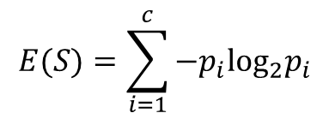

CART
Think about
Decision Tree Building
Entropy = 0 / Entropy =1 ?
Why is information gain a good tool to choose best attribute? What is the intuition behind?
What kind of features would you like to collect?
Notes:
Draw backs: attributes should categorical
should be independent example: gender and passenger class. For example, the older people have more money, so they are more likely to buy the first class ticker.
because information gain can reflect how much the attributes provide information. can reduce the uncertainty of the information

Slide 5
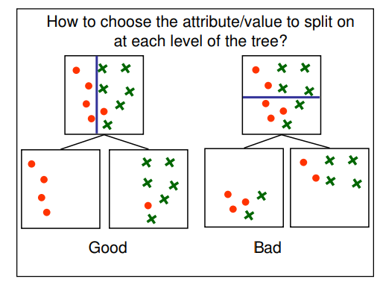
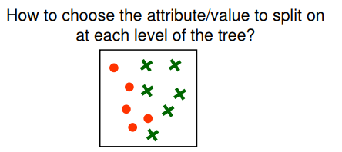
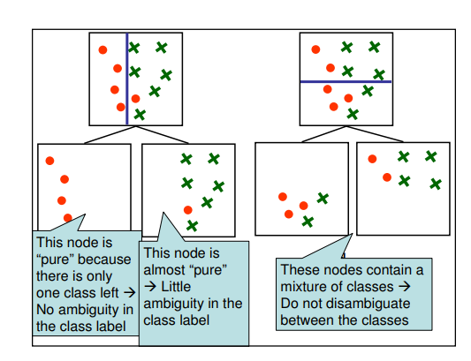
“Bad” root attribute

Slide 6
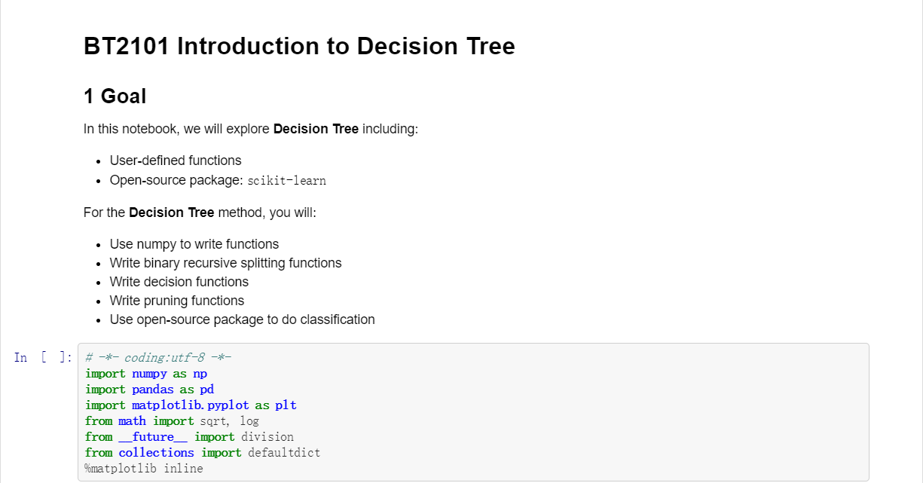
Implementation in Python
Notes:
10 min

Slide 7
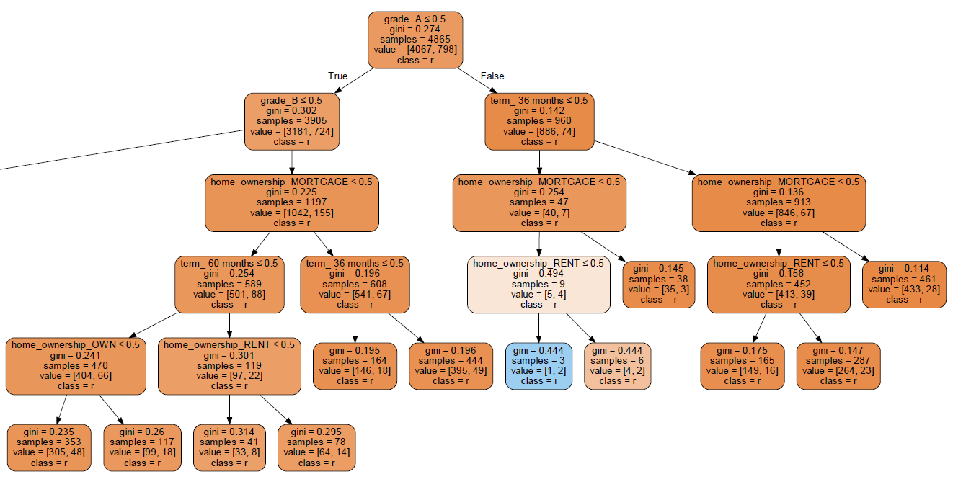
Implementation in Python
Notes:
10 min

Slide 8
Assignment 1
User-defined function: Write functions to use Gini index and misclassification error rate as metrics for binary splitting
Use Titanic dataset (“train.csv”); Fit the model using “scikit-learn” with different metrics (e.g., information gain, gini index)
Observe and report the differences (e.g., best features for splitting, tree structure, performance, etc.)
Notes:
10 min

Slide 9
Thank you!

